Slide 1
Tutorial 3
Ziren
u4975835@anu.edu.au
Thursday 10am to 11 am or by appointment
CBE 3.09

Slide 2
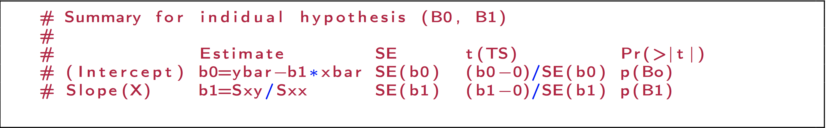
Revision – hypothesis testing

Slide 3
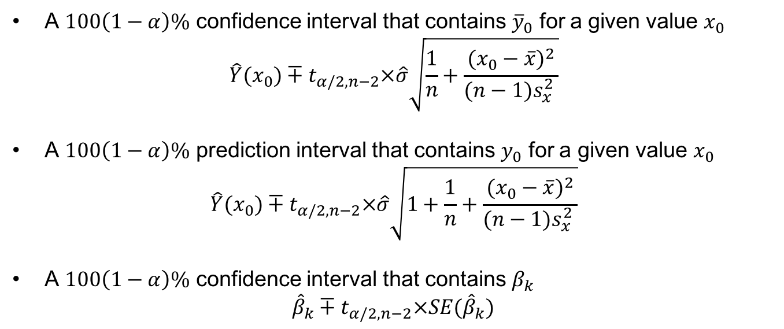
Revision – CI&PI
A $100\left(1−α\right)\%$ confidence interval that contains ${\overline{y}}_{0}$ for a given value $x_{0}$
$$\hat{Y}(x_{0})∓t_{α/2,n−2}×\hat{σ}\sqrt{\frac{1}{n}+\frac{{(x_{0}−\overline{x})}^{2}}{(n−1)s_{x}^{2} }}$$
A $100\left(1−α\right)\%$ prediction interval that contains $y_{0}$ for a given value $x_{0}$
$$\hat{Y}(x_{0})∓t_{α/2,n−2}×\hat{σ}\sqrt{1+\frac{1}{n}+\frac{{(x_{0}−\overline{x})}^{2}}{(n−1)s_{x}^{2} }}$$
A $100\left(1−α\right)\%$ confidence interval that contains $β_{k}$
$${\hat{β}}_{k}∓t_{α/2,n−2}×SE({\hat{β}}_{k})$$

Slide 4
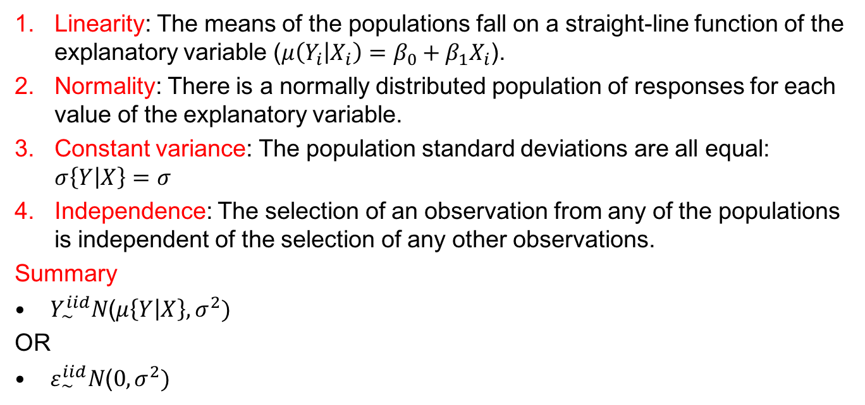
Revision – Diagnostics
Linearity: The means of the populations fall on a straight-line function of the explanatory variable ($μ\left(Y_{i} | X_{i}\right)=β_{0}+β_{1}X_{i}$).
Normality: There is a normally distributed population of responses for each value of the explanatory variable.
Constant variance: The population standard deviations are all equal: $σ\left\{Y | X\right\}=σ$
Independence: The selection of an observation from any of the populations is independent of the selection of any other observations.
Summary
$Y_{∼}^{iid}N\text{(}μ\left\{Y | X\right\},σ^{2}\text{)}$
OR
$ε_{\sim }^{iid}N\text{(}0,σ^{2}\text{)}$

Slide 5
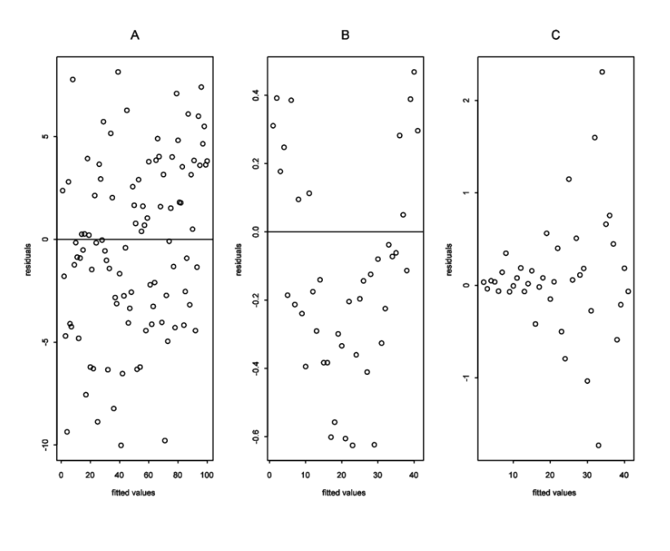
Revision – Residual vs Fitted Plot
A – No violation of assumptions
B – Violation of Independence (a definite pattern)
C – Violation of constant variance (heteroscedasticity)
# Can also assess linearity – residuals are supposed to have zero mean

Slide 6
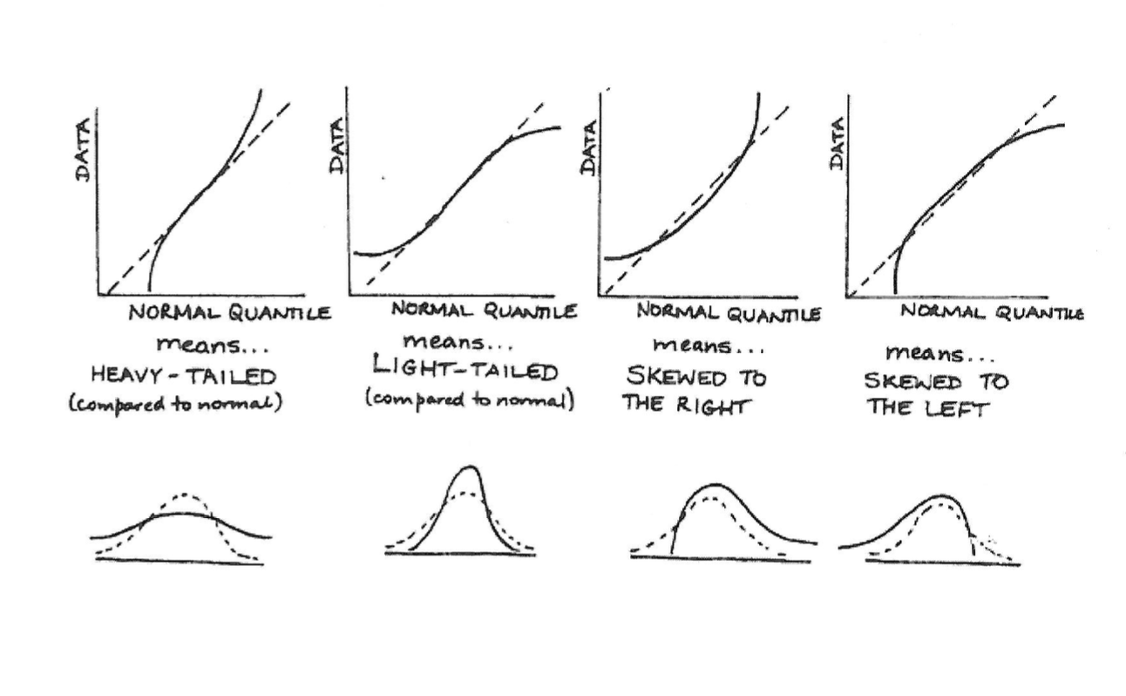
Revision – Normal Q-Q Plot
# To assess the assumption of Normality

Slide 7
Question 1
The file “ex0727.csv” contains measured distances and recession velocities for 10 clusters of nebulae. According to a theory by Hubble the mean of the measured distance, as a function of velocity, should be β_{1*}velocity (i.e., μ(distance|velocity) = β_{1*}velocity), and β₁ is the age of the universe.
Are the data consistent with the theory that the intercept (β₀) is zero?
Produce a 95% confidence interval for the estimate in part (2) of Question 1 in Tutorial 2.

Slide 8
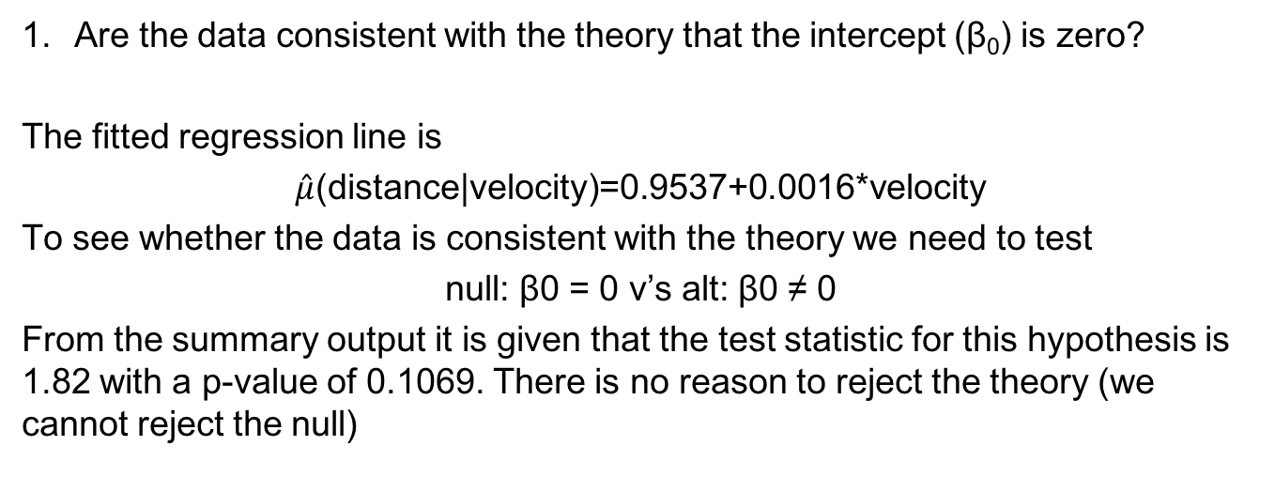
Answer
Are the data consistent with the theory that the intercept (β₀) is zero?
The fitted regression line is
$\hat{μ}$(distance|velocity)=0.9537+0.0016*velocity
To see whether the data is consistent with the theory we need to test
null: β0 = 0 v’s alt: β0 ≠ 0
From the summary output it is given that the test statistic for this hypothesis is 1.82 with a p-value of 0.1069. There is no reason to reject the theory (we cannot reject the null)

Slide 9
Answer
2. Produce a 95% confidence interval for the estimate in part (b) of Question 1 in Tutorial.
Our estimate of β1 was 0.0017 with a SE of 0.000048. A 95% CI for β1 is given by:
(0.0017-t(0.975,9)*0.000048, 0.0017+t(0.975,9)*0.000048)
=(0.0016, 0.0018)
converting this CI to years gives (1.59 billion, 1.80 billion)

Slide 10
Question 2
Black wheatears are small birds of Spain and Morocco. Males of the species demonstrate an exaggerated sexual display by carrying many heavy stones to nesting cavities. Different males carry somewhat different sized stones, prompting a study of whether larger stones may be a signal of higher health status. A study was conducted (M. Soler et al.) which calculated the average stone mass (g) carried by each of 21 male wheatears, along with T-cell response measurements reflecting their immune systems’ strengths. The file “ex0729.csv” contains the data.
Does the data suggest there is a linear relationship between the mean T-cell response and average stone mass?
If a particular wheatear carries stones that have an average mass of 6.5g, what would you predict its T-cell response to be? Provide a 90% prediction interval for this prediction.

Slide 11
Answer
Does the data suggest there is a linear relationship between the mean T-cell response and average stone mass?
We want to test
null: β1 = 0 v’s alt: β1 ≠ 0
From the summary output we are given that the p-value for this test is 0.0061. We reject the null and conclude that there is a linear relationship.

Slide 12


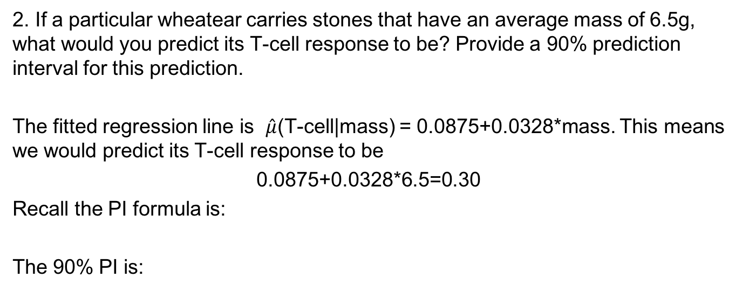
Answer
2. If a particular wheatear carries stones that have an average mass of 6.5g, what would you predict its T-cell response to be? Provide a 90% prediction interval for this prediction.
The fitted regression line is $\hat{μ}$(T-cell|mass) = 0.0875+0.0328*mass. This means we would predict its T-cell response to be
0.0875+0.0328*6.5=0.30
Recall the PI formula is:
The 90% PI is:

Slide 13
Question 3
The data in the file “ex0823.csv” are the average wine consumption rates (in litres per person) and number of ischemic heart disease deaths (per 1000 men aged 55 to 64 years old) for 18 industrialised countries.
Do these data suggest that the heart disease rate is associated with average wine consumption? (You will need to transform the data before fitting the SLR)

Slide 14
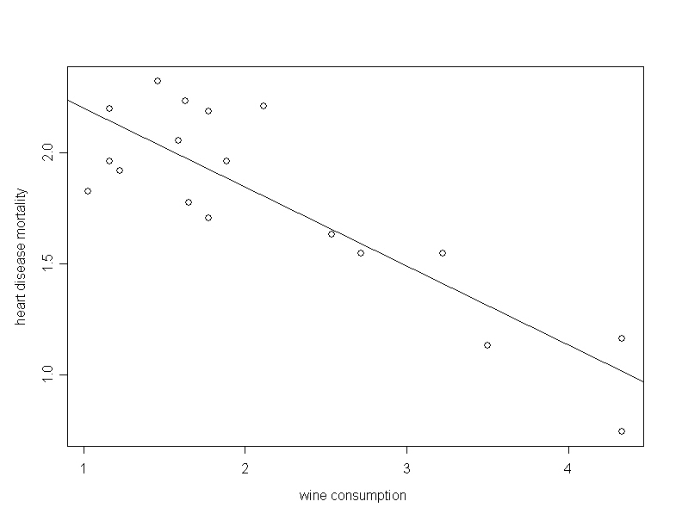
Answer
Do these data suggest that the heart disease rate is associated with average wine consumption? (You will need to transform the data before fitting the SLR)
The log-log scale provides the best looking straight line fit.
There is strong evidence of an association between wine consumption and mortality – the test of null: β₁ = 0 v’s alt: β₁ ≠ 0 has a p-value of <0.01.

Slide 15
Question 4
In a study of the effectiveness of biological control of the exotic weed tansy ragwort, researchers manipulated the exposure to the ragwort flea beetle on 15 plots that had been planted with a high density of ragwort. Harvesting the plots the next season, they measured the average dry mass of ragwort remaining (grams/plant) and the flea beetle load (beetles/gram of ragwort mass) to see if the ragwort plants in the plots with high beetle loads were smaller as a result of herbivory by the beetles. The data is contained in the file “ex0817.csv”.
1. Use scatterplots of the raw data, along with trail and error, to find a transformation of Y = Ragwort dry mass and X = Flea beetle load that will be suitable for a SLR. Try the following transformations: log, square root, and reciprocal.
2. Use a residual plot to check whether the transformations you choose seem appropriate.

Slide 16
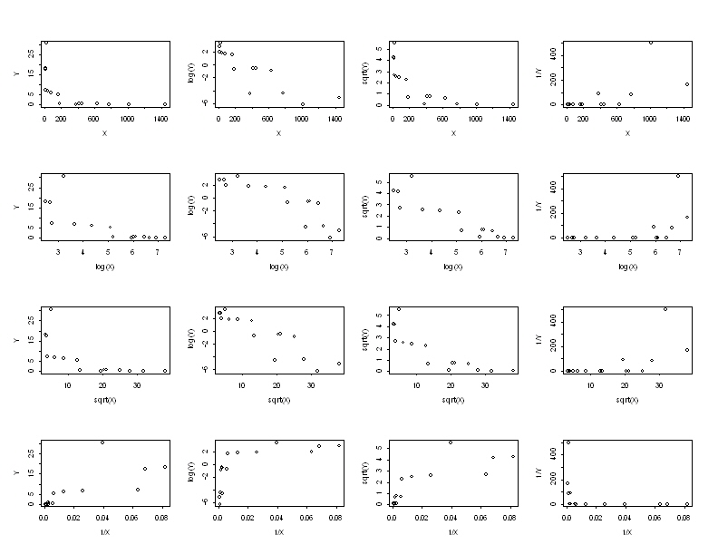
Answer
Use scatterplots of the raw data, along with trail and error, to find a transformation of Y = Ragwort dry mass and X = Flea beetle load that will be suitable for a SLR. Try the following transformations: log, square root, and reciprocal.

Slide 17
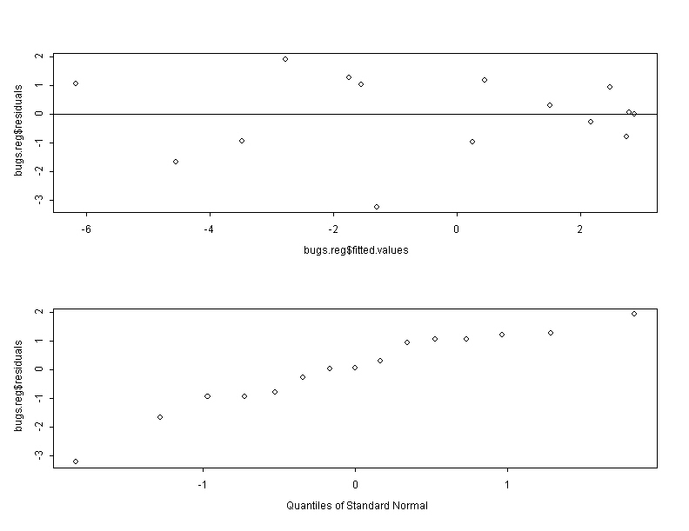
Answer
2. Use a residual plot to check whether the transformations seem appropriate.

Slide 18
Question 5
Studies over the last two decades have shown that activity can effect the reorganisation of the human central nervous system. For example, it is known that the part of the brain associated with activity of a finger or limb is taken over for other purposes in individuals whose limb or finger has been lost. In one study, psychologists used magnetic source imaging (MSI) to measure neuronal activity in the brains of nine string players (six violinists, two cellists, and one guitarist) and six controls who had never played a musical instrument, when the thumb and fifth finger of the left hand were exposed to mild stimulation. The researchers felt that stringed instrument players, who use the fingers of their left hand extensively, might show different behaviour in the brain – as a result of this extensive physical activity – than individuals who did not play stringed instruments. The file “violin.csv” contains data on the neuron activity index from the MSI and number of years that the individual had been playing a stringed instrument (zero for the controls).
Is the neuron activity different in the stringed musicians and the controls?
Is the amount of neuron activity associated with the number of years the individual had been playing the instrument?

Slide 19
Answer
Is the neuron activity different in the stringed musicians and the controls?
We can then test whether The test statistic is -5.19 with a corresponding p-value of 0.0002. We reject the null and conclude that neuron activity is different in the stringed musicians.

Slide 20
Answer
2. Is the amount of neuron activity associated with the number of years the individual had been playing the instrument?
We can then test whether The test statistic for this test is 9, implying that we reject the null. We estimate that the mean neuronal index increases by 1.0 unit for each one-year increase in musical activity.

Slide 21
Question 6
The file “vote.csv” contains data on the number of votes for Buchannan and Bush in all 67 counties in Florida.
Produce plots of the number of Buchannan votes versus the number of Bush votes and another plot for the log of these two variables. Does the log-log transformation appear better for performing a simple linear regression?
Analyse the data without the Palm Beach County results to obtain an equation for predicting Buchannan votes from Bush votes.
Use the residual and normal probability plots from the regression in (2) to check the adequacy of the model.
Obtain a 95% prediction interval for the number of Buchannan votes in Palm Beach – assuming the relationship is the same in this county as the others.
Comment on the result in (4) given that Buchannan actually received 3407 votes in Palm Beach County.

Slide 22
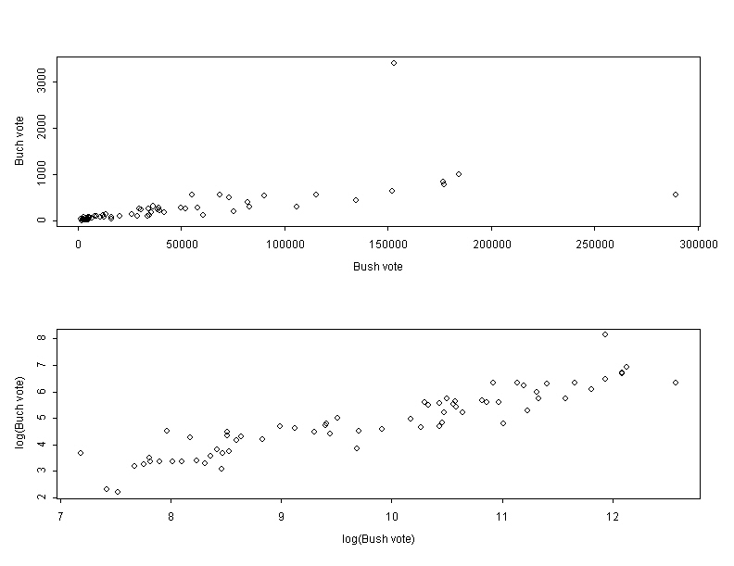
Answer
Produce plots of the number of Buchannan votes versus the number of Bush votes and another plot for the log of these two variables. Does the log-log transformation appear better for performing a simple linear regression?
The log-log transformation looks better for use in a SLR.

Slide 23
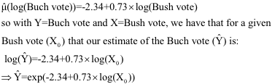
Answer
2. Analyse the data without the Palm Beach County results to obtain an equation for predicting Buchannan votes from Bush votes.
The fitted regression line is:

Slide 24
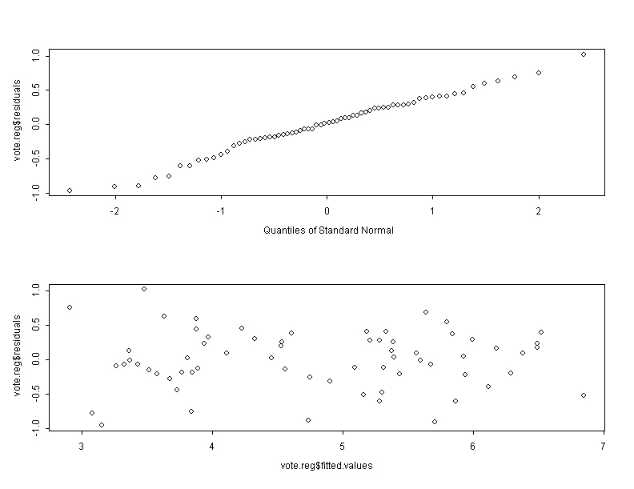
Answer
3. Use the residual and normal probability plots from the regression in (2) to check the adequacy of the model.
These plots are reasonable, suggesting that SLR model is appropriate.

Slide 25

Answer
4. Obtain a 95% prediction interval for the number of Buchannan votes in Palm Beach – assuming the relationship is the same in this county as the others.
The number of Bush votes in Palm Beach was 152846. Using the model from 2) we predict that there would be for Buchannan. A 95% PI interval is given by:

Slide 26
Answer
5. Comment on the result in (4) given that Buchannan actually received 3407 votes in Palm Beach County.
The observed number of votes for Buchannan is way outside the upper limit of the 95% PI. This is would make us suspect that something was different in Palm Beach.

